Slide 1
American Rescue Plan Act
County/City/Township Coordination Meeting
June 15, 2021

Slide 2
ARPA Overview & Eligible Projects
General Criteria:
Respond to the public health emergency or its negative economic impacts
1.) Identify a need or negative impact of COVID-19
2.) Identify how the program, service, or other intervention addresses the identified need or impact
Replace lost revenue
Investments in water, sewer or broadband infrastructure
Premium pay for essential workers

Slide 3
City/Township Funds
75% of most recent budget adopted as of Jan. 27 , 2020
Request funds: https://mn.gov/mmb/covid-19-response-accountability-office/arp/local-governments/
Reporting to MN Management & Budget

Slide 4
Potential County Projects
County Direct Costs
Public Health
Economic Development
Business Assistance
Technical Support
Commercial Rehab Program
Housing – Lakes & Pines
Owner Occupied Rehab Program
Rental Rehab Program
Food Support
Broadband (grants to existing providers)
Pine Technical & Community College
Tuition Assistance for Hinckley-Finlayson, East Central, & Willow River Graduates
Business Technical Assistance & Grants
WorkFast Program
Other?

Slide 5
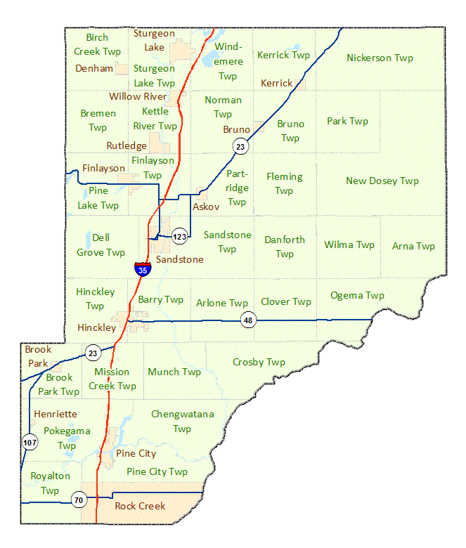
Partnerships?
Targeted towards specific township/city:
Broadband
Pine Tech & Community College Programs
Rehab Programs
Map retrieved from: https://www.dot.state.mn.us/maps/gdma/data/mapfinder/countyHTMLs/pine.html

Slide 6
Questions?
David Minke, County Administrator
(320) 591-1620 or David.Minke@co.pine.mn.us
Lezlie Sauter, Economic Development Coordinator
(320) 591-1619 or Lezlie.Sauter@co.pine.mn.us
Kelly Schroeder, County Auditor-Treasurer
(320) 591-1668 or Kelly.Schroeder@co.pine.mn.us

